Slide 1
The Ketogenic diet
Luke Nikitow
and
Chase Dudley

Slide 2
Ketogenic diet
Introduced 1920’s to control epileptic seizures
Dr. Russel Wilder of Mayo Clinic
Eating strategy: to force body to burn stored fat for energy
Ketosis
High fat, moderate protein, low carbohydrate
65-75% fat, 15-30% protein, 5-10% carbs
Anticonvulsant drugs introduced – diet abandoned
1921 - Endocrinologist Rollin Woodyatt
Ketones produced by liver

Slide 3
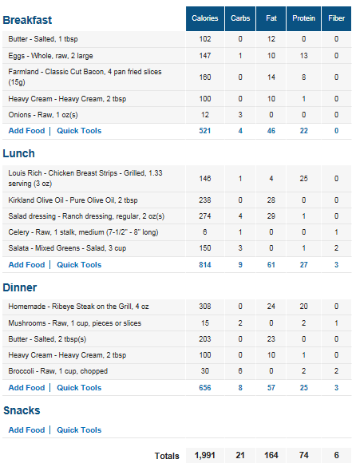
Ketogenic meal plan
Fat to protein ratio is key
Very low carbohydrates – most will come from vegetables
Balance is integral for results

Slide 4

Potential Benefits
Social
Most commonly used for weight loss
Clinical
Decrease epileptic seizures
Decrease cancer cell activity

Slide 5
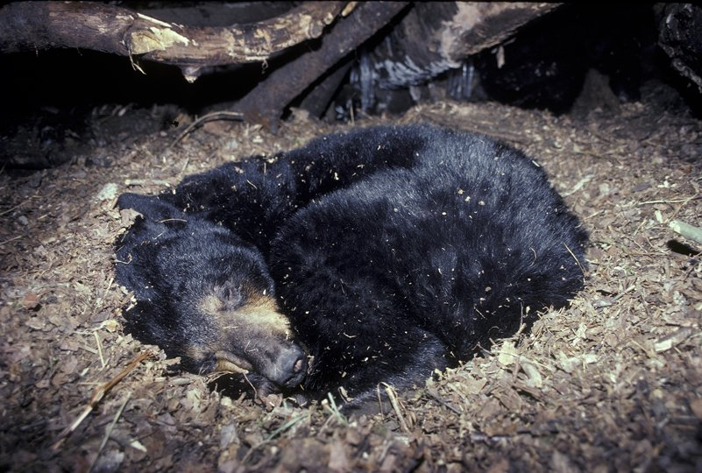
What is ketosis?
Metabolic process that occurs when body is glucose deficient
Stored fats are broken down
build-up of acids called ketones within the body
Ketones then used for energy rather than glucose

Slide 6
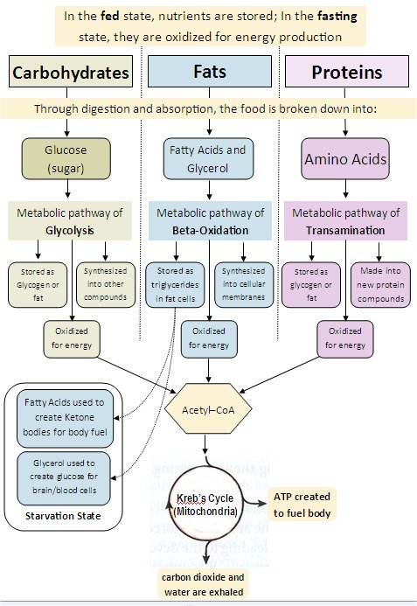
Metabolic pathways
Decreased carbs
Focus turns to fats
Leads to “starvation state”
Ketone bodies
Acetone
Beta-hydroxybutryate
Acetoacetate

Slide 7
Weight loss
Decreased carbs (glucose)
Decreases insulin (Insulin tells body to store fat)
Stored body fat is mobilized for metabolic use more readily
Ketones made from stored fats
Used for energy
Insulin regulation
Therefore – effective for weight loss

Slide 8
epilepsy
With decrease in glucose, ketones are used for energy production in brain
Ketones have higher energy than glucose
Easily cross blood brain barrier
Hypothesized that due to this there is a decrease in epileptic seizures
Also found to possibly help Parkinson's and Alzheimer's

Slide 9
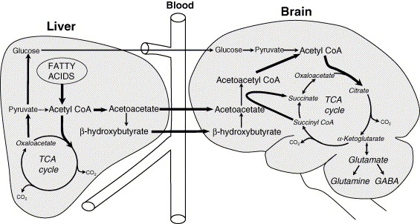
Ketosis in the brain

Slide 10
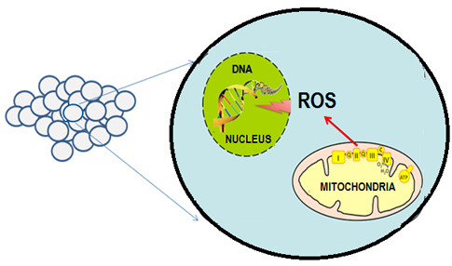
Cancer
Cancer cells have altered metabolism
Increased Reactive oxygen species (damaging)
So they take in glucose to stabilize and combat these ROS’s
Hypothesis: decrease glucose is starving the cancer cells, ROS will destroy cancer cells.

Slide 11
Bibliography
Allen, B. G., Bhatia, S. K., Anderson, C. M., Eichenberger-Gilmore, J. M., Sibenaller, Z. A., Mapuskar, K. A., … Fath, M. A. (2014). Ketogenic diets as an adjuvant cancer therapy: History and potential mechanism. Redox Biology, 2, 963–970. doi:10.1016/j.redox.2014.08.002
Barañano, K. W., & Hartman, A. L. (2008). The Ketogenic Diet: Uses in Epilepsy and Other Neurologic Illnesses. Current Treatment Options in Neurology, 10(6), 410–419.
(2004). Ketogenic diets and physical performance. Nutrition & Metabolism, 1(1), 2.
Liou, G.-Y., & Storz, P. (2010). Reactive oxygen species in cancer. Free Radical Research, 44(5), 10.3109/10715761003667554. doi:10.3109/10715761003667554
Metabolic Pathways: How Ketosis Works. (2015). Retreived May 22, 2015 from http://www.ketogenic-diet-resource.com/metabolic-pathways.html
What is Ketosis? What causes Ketosis? (2015). Retreived May 28, 2015 from http://www.medicalnewstoday.com/articles/180858.php

